Slide 1


Prep On!
Empowering USC MSBA Career Success with AI
Present Date: Sept 27th 2025
Present Team: Unify

Slide 2


The Client & Business Need
MSBA
Career Advisors
MSBA Students
Limited Opportunities
(Hard to find practice sessions)
Generic Tools
(Industry-specific)
Time Constraints
(Limited 1-on-1 support)
Scalability Issue
(Cannot serve all students)
Objective
On demand, and Tailored Interview Preparation for USC MSBA Students and Career Advisors
PrepOn looks to be a tool for Career Advisors
Keep up with the trends and changes in Industries
Notes:
Our client is the USC MSBA Community, made up of both students and faculty.
Students include both first- and second-years, domestic and international, who are career-driven and facing recruiting cycles. Their main problems are interview pressure, limited personalized practice, and reliance on generic tools.
On the other hand, faculty members — career strategists, advisors, and professors — face their own problems: time constraints, scalability issues, and generic resources that are not MSBA-specific.
Taken together, these challenges create a clear unmet demand: scalable, affordable, and tailored interview preparation for MSBA students.

Slide 3






Workshops
Ideation Sources
Source: Team brainstorming
Insight: Opportunity to
leverage AI for
scalable, tailored prep
Tools
Source: Benchmarking existing tools
Insight: Costly, not MSBA-specific
Faculties
Source: Advisor input
Insight: Limited bandwidth
for personalized support
Peers
Source: Coffee chats & conversations
Insight: Recruiting is top priority,
high interview stress

Slide 4
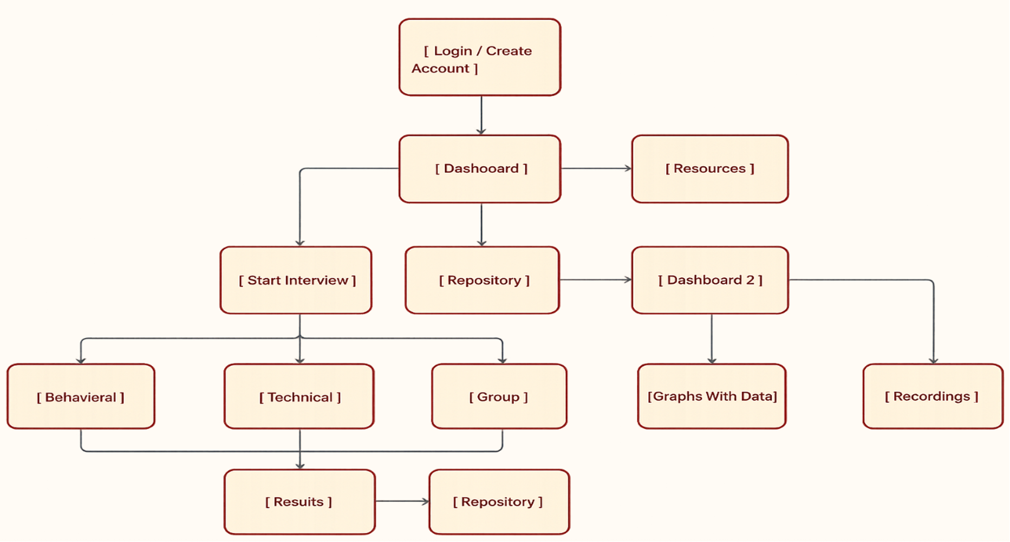

Wireframe
Login/create account
Dashboard
Resources
Start
Interview
Repository
Dashboard 2
Graphs
with Data
Behavioral
Technical
Group
Recording
Results
Repository

Slide 5







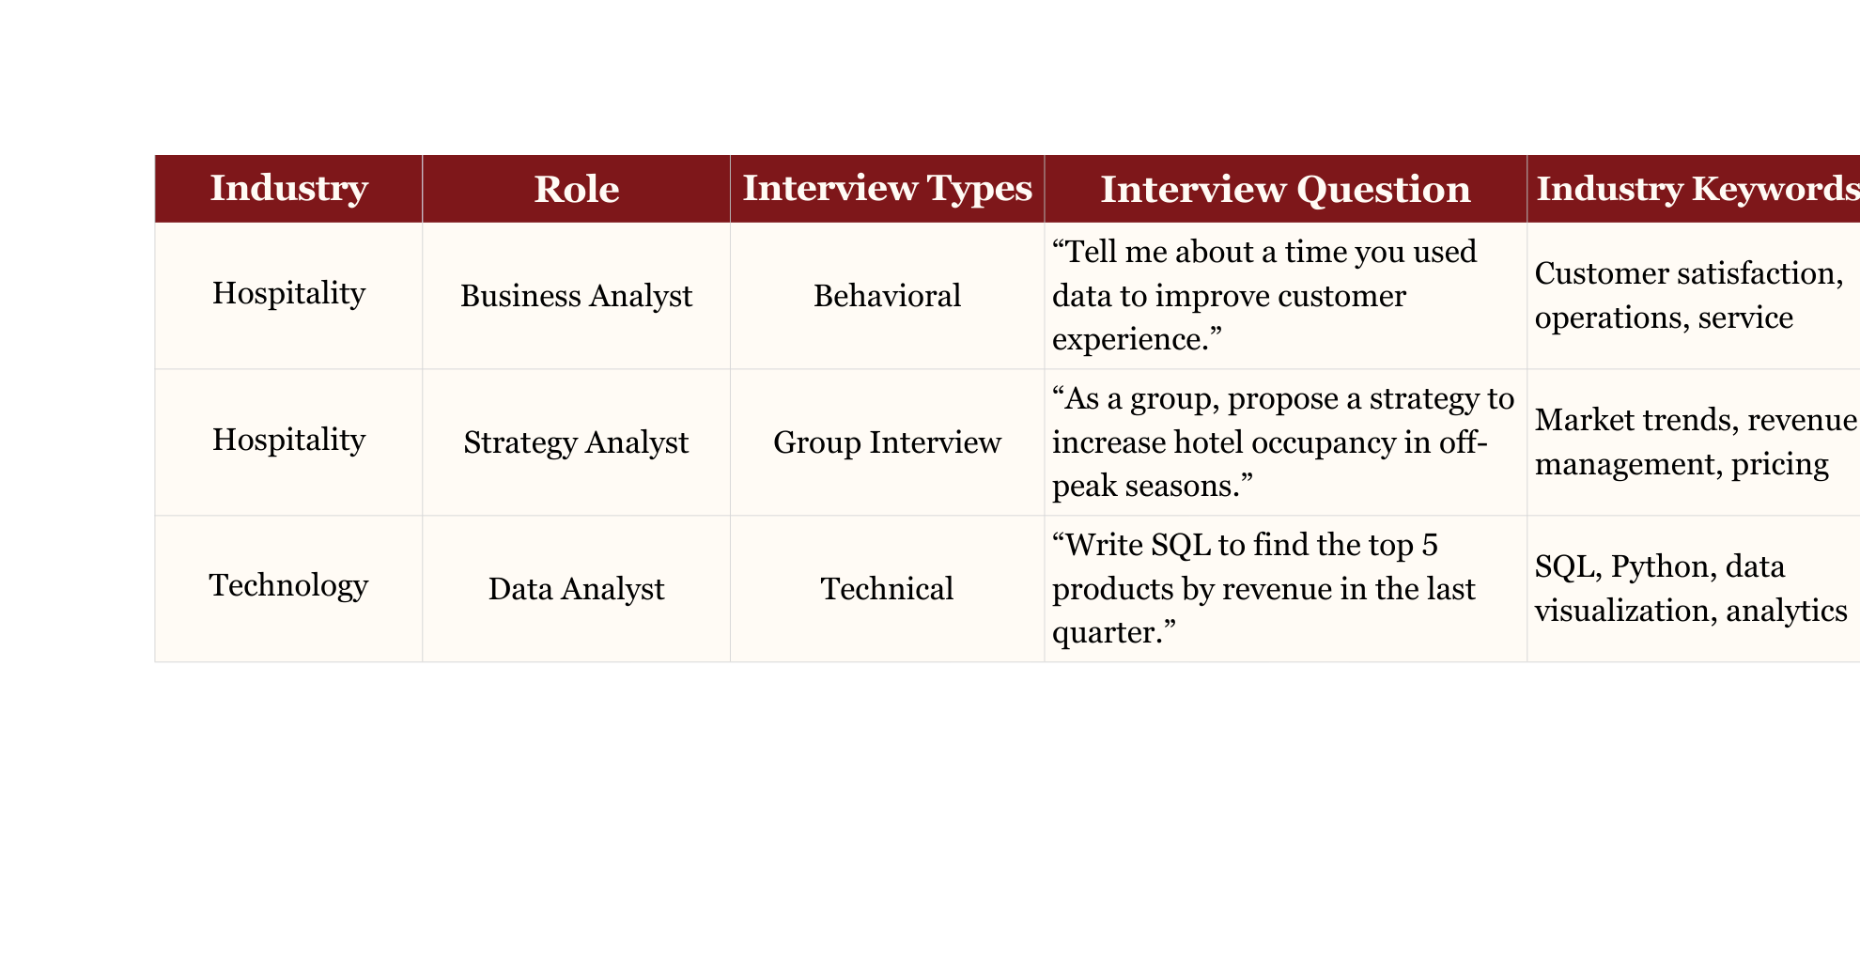
Methodology

Slide 6
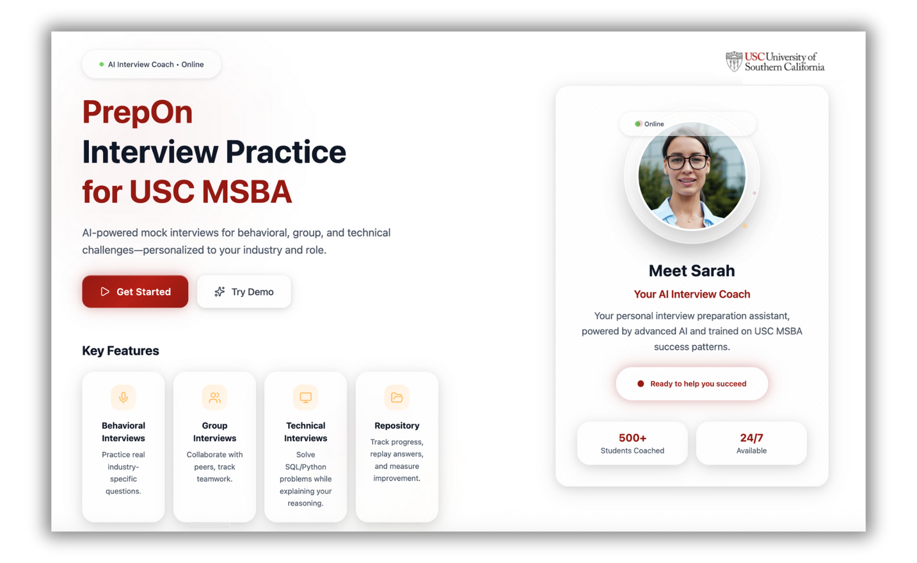
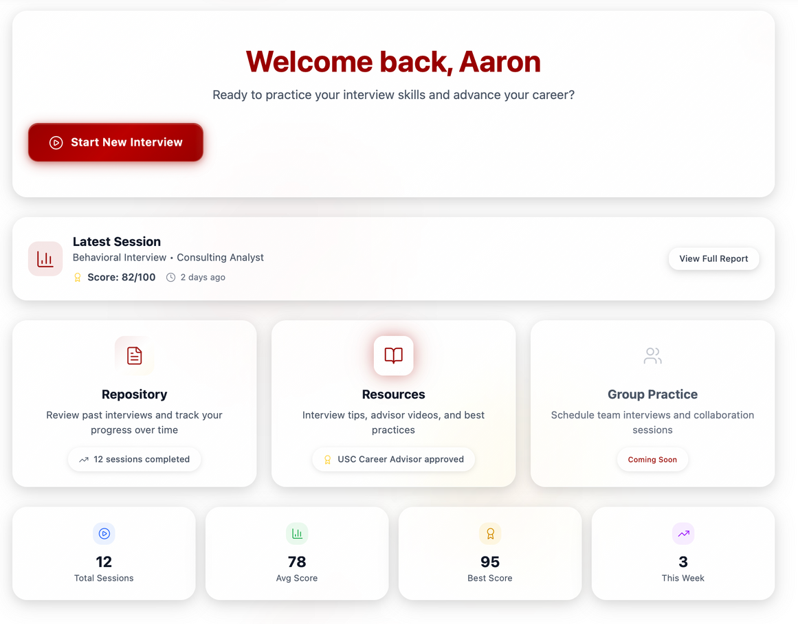
Landing Page

Slide 7
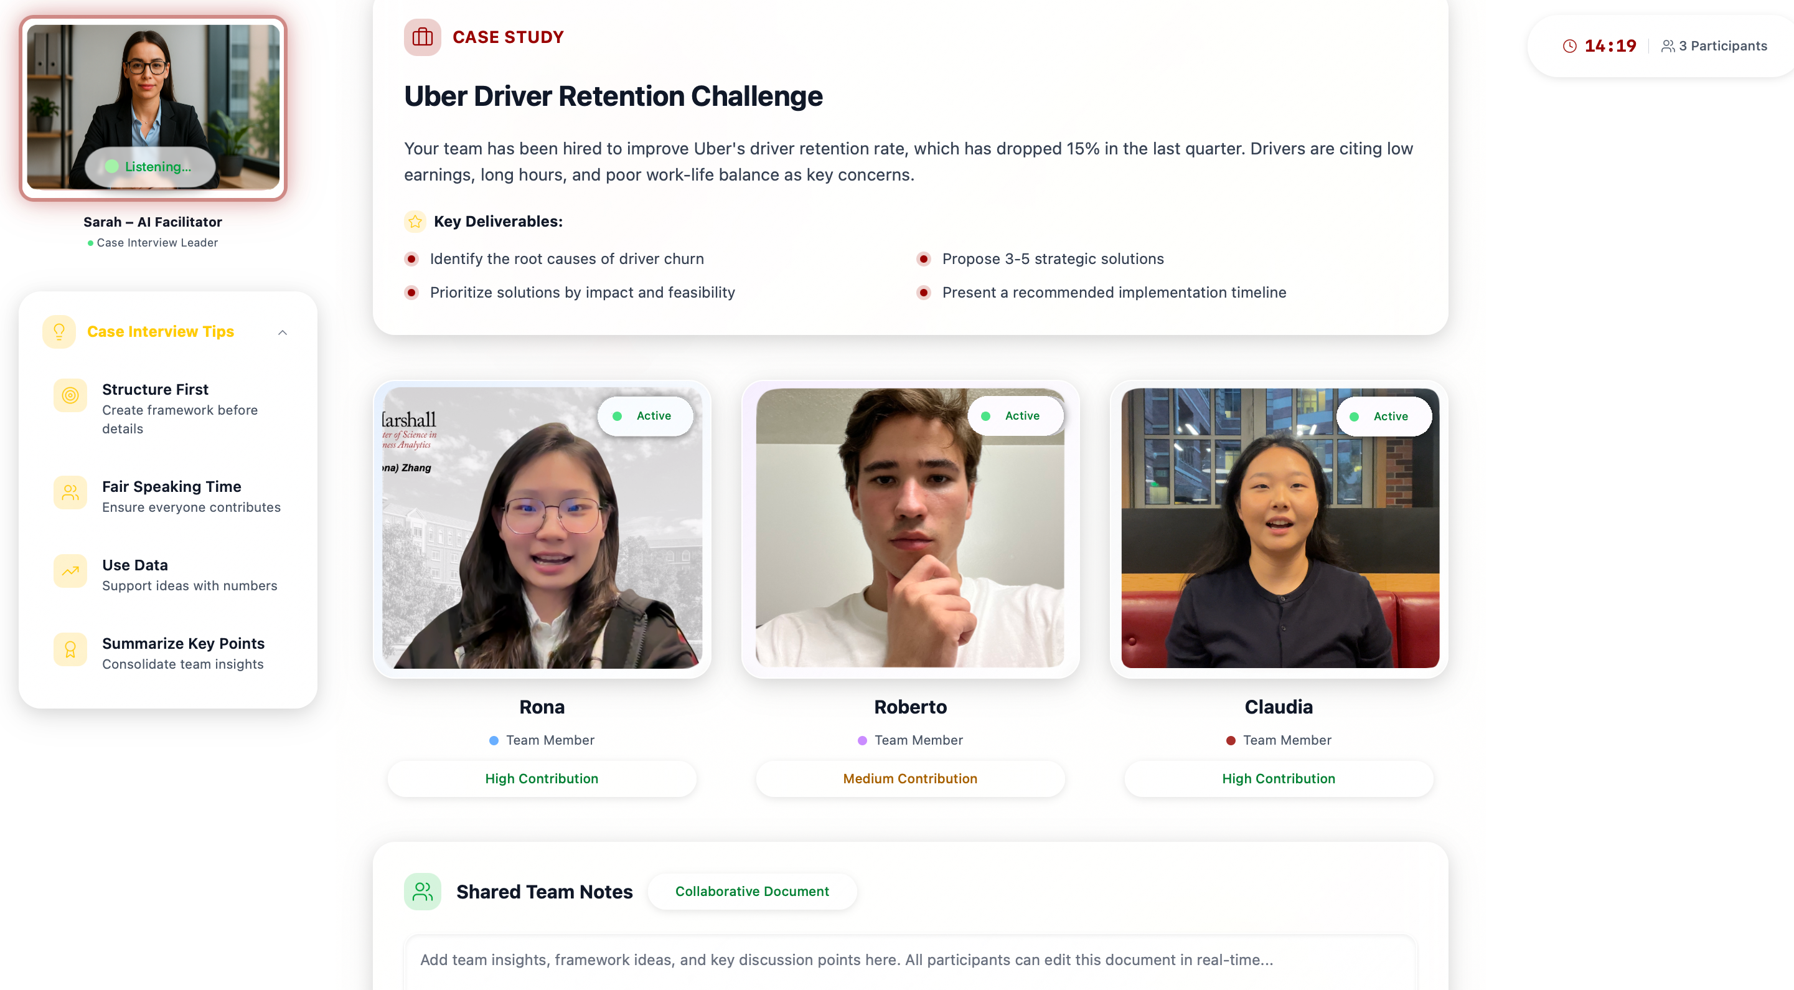
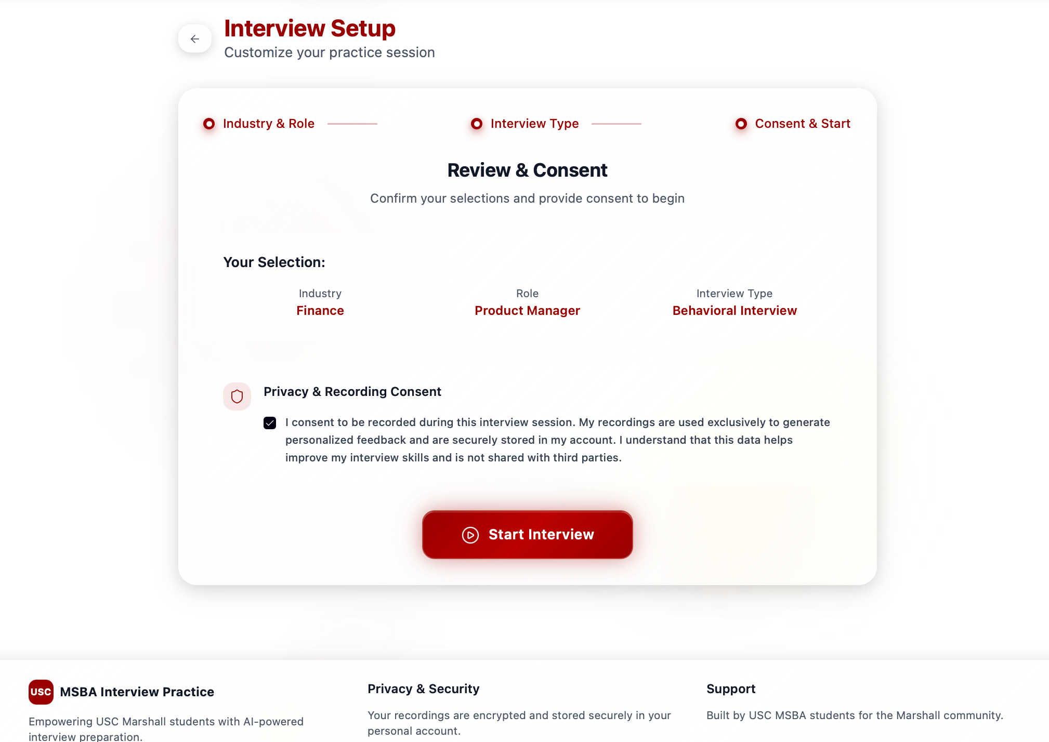
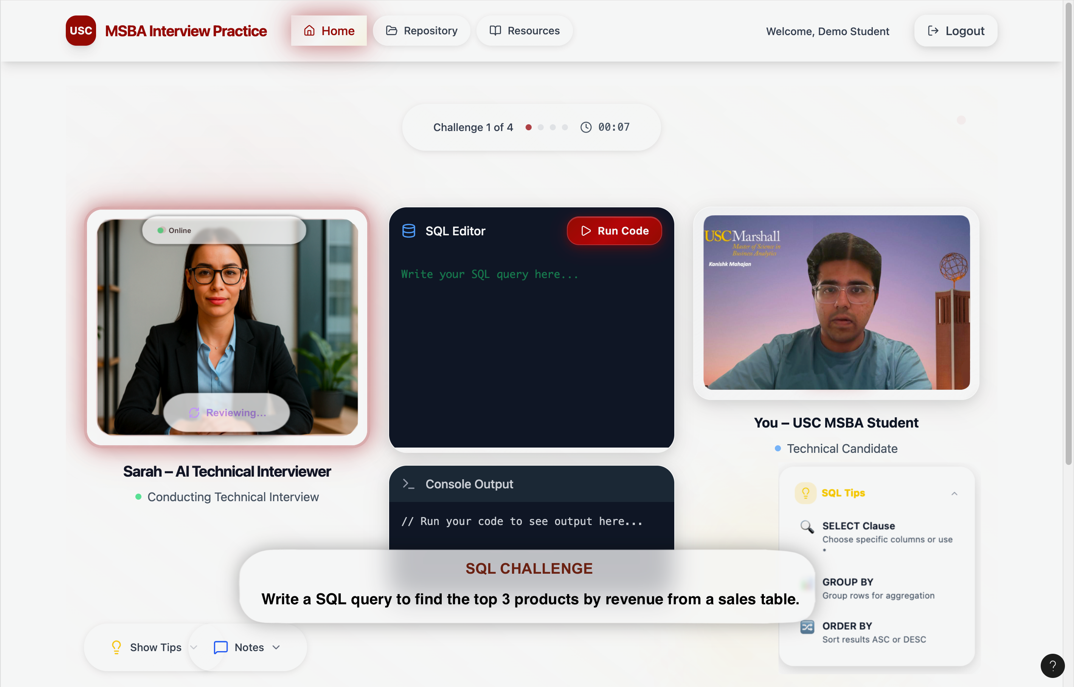
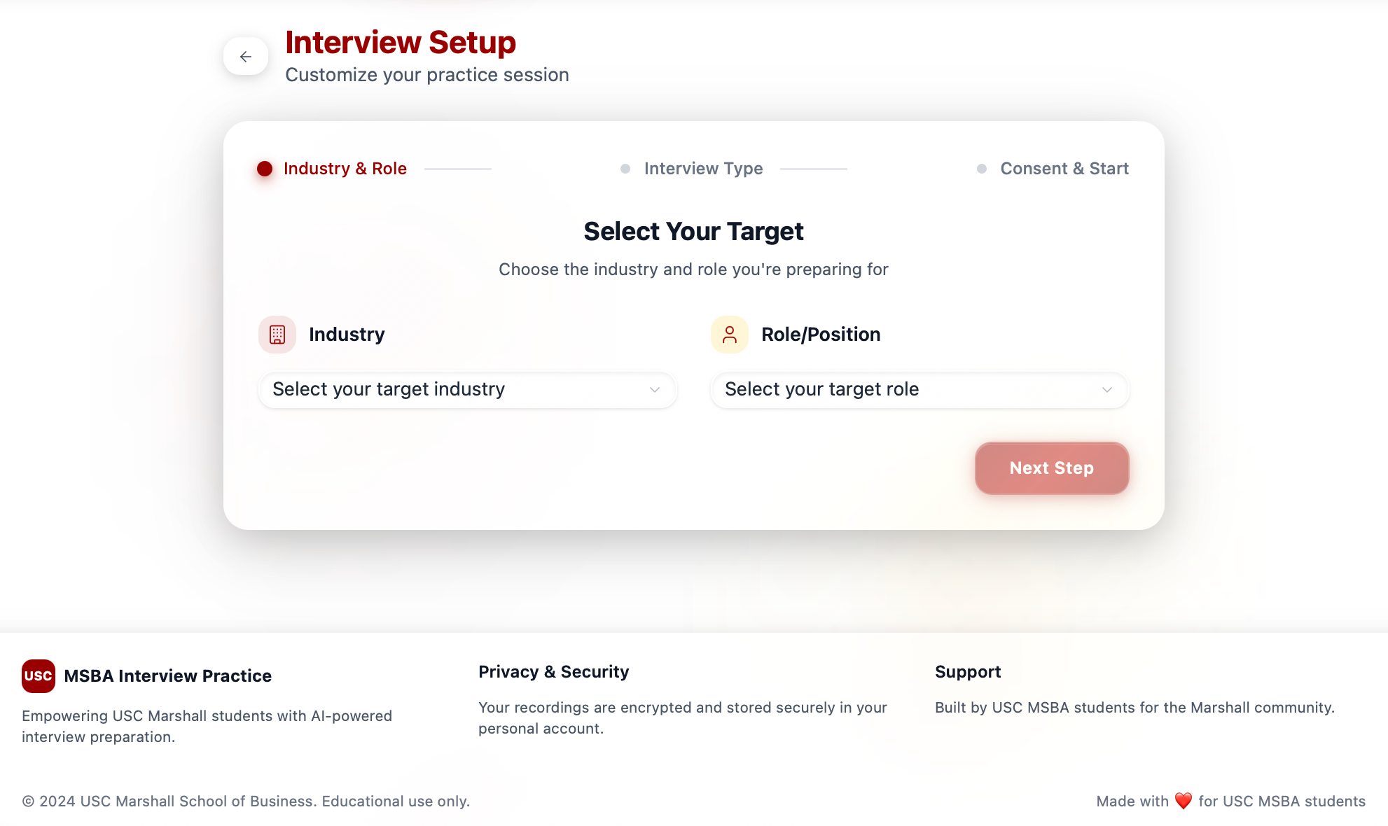
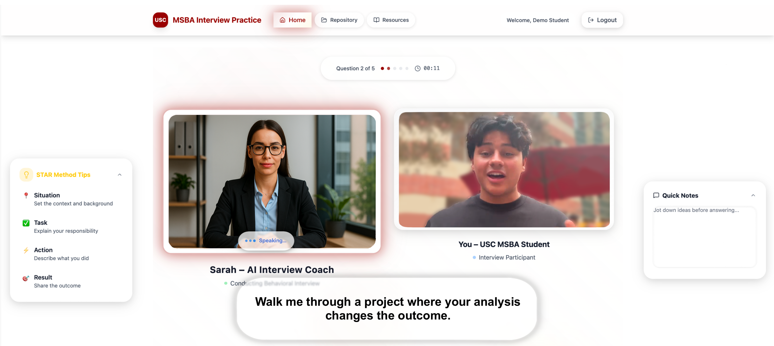
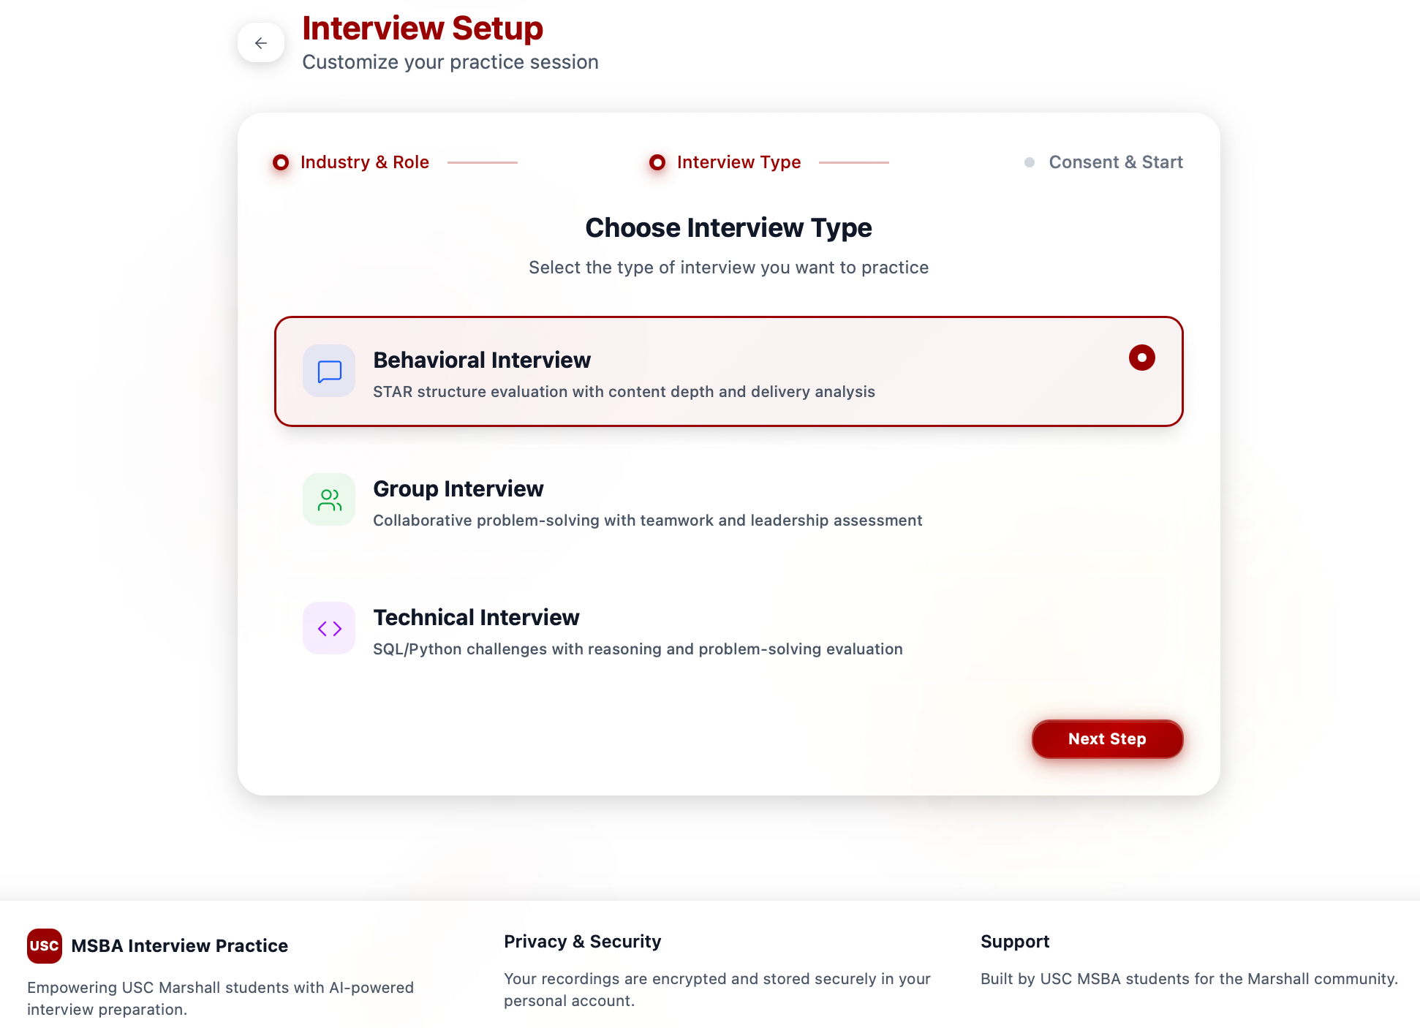
Practice Session Screen

Slide 8
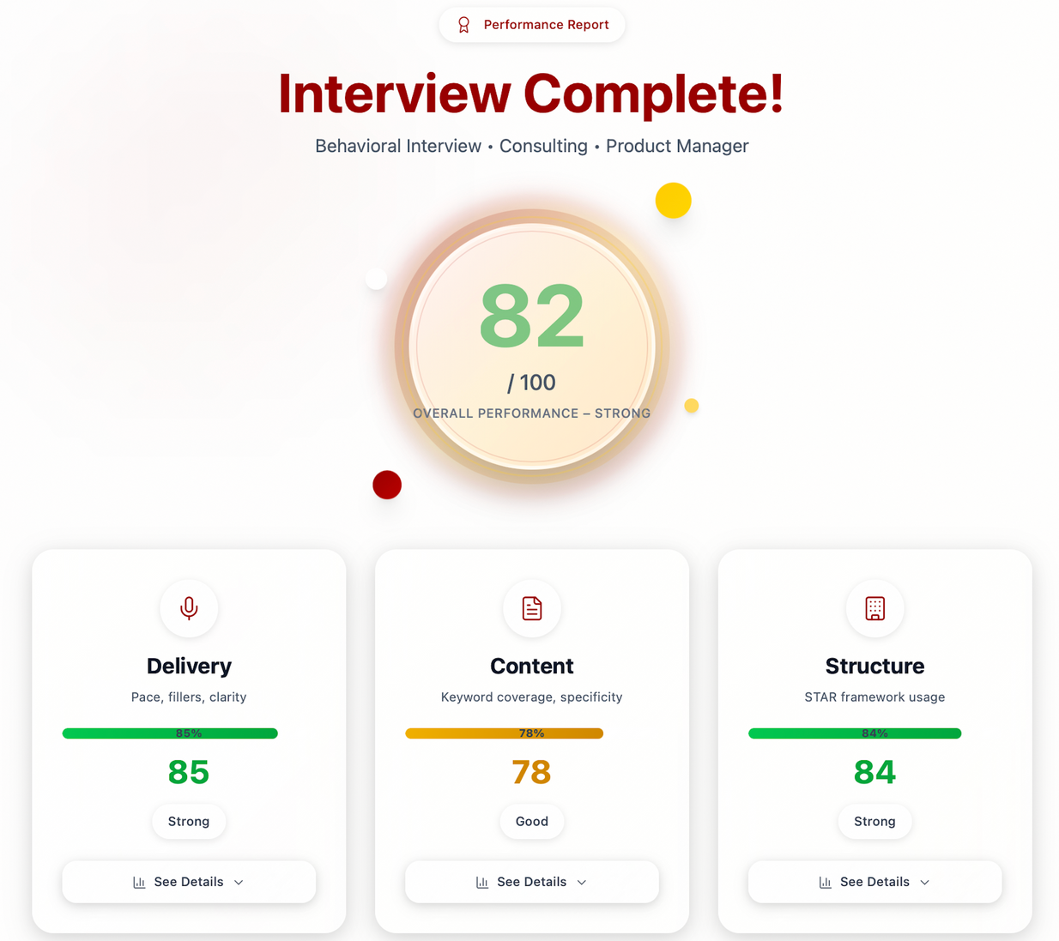
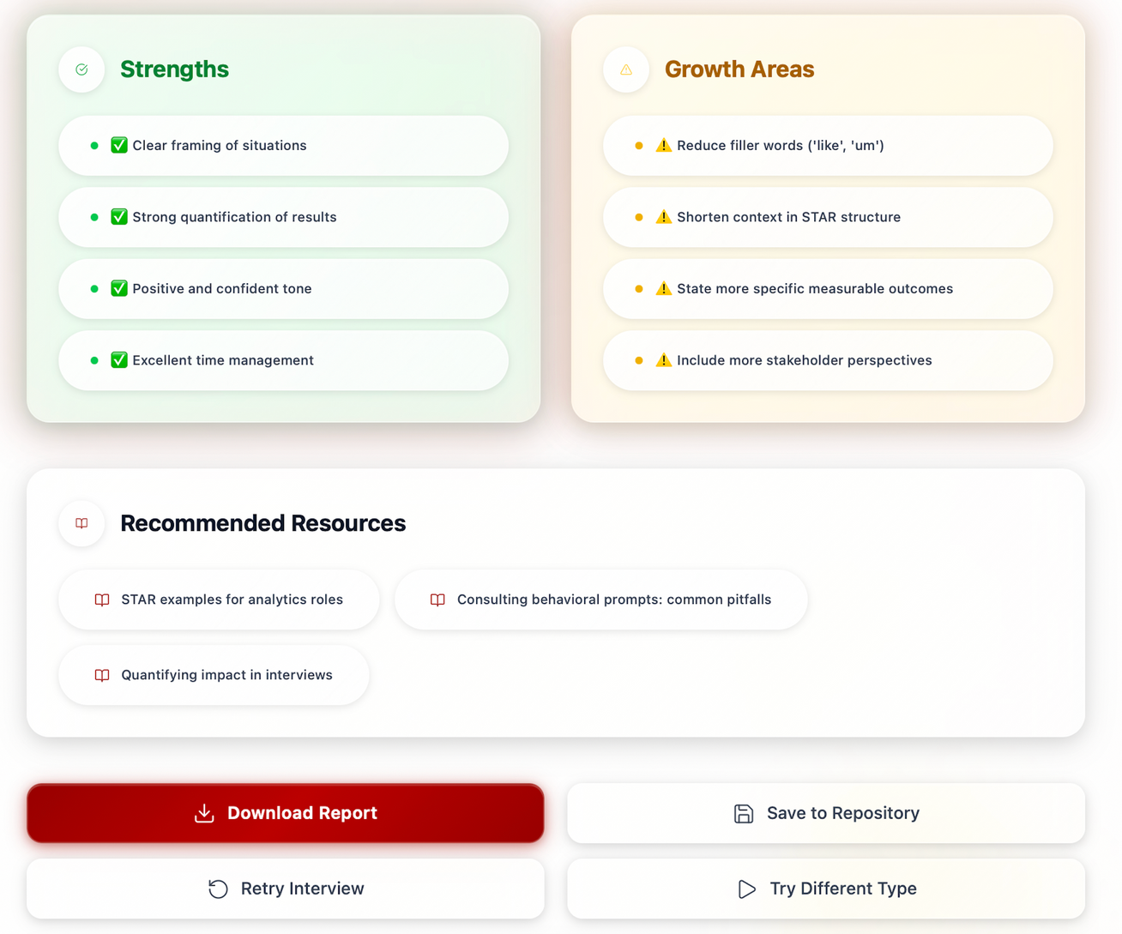
AI Feedback Screen
Grade Report

Slide 9
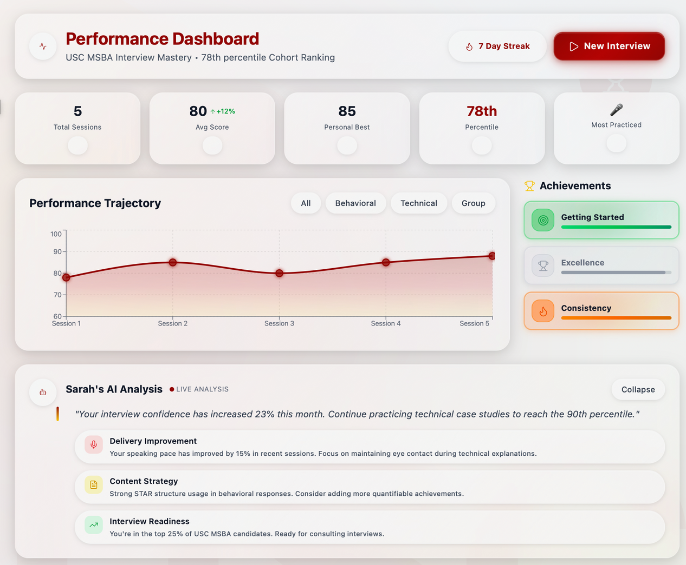
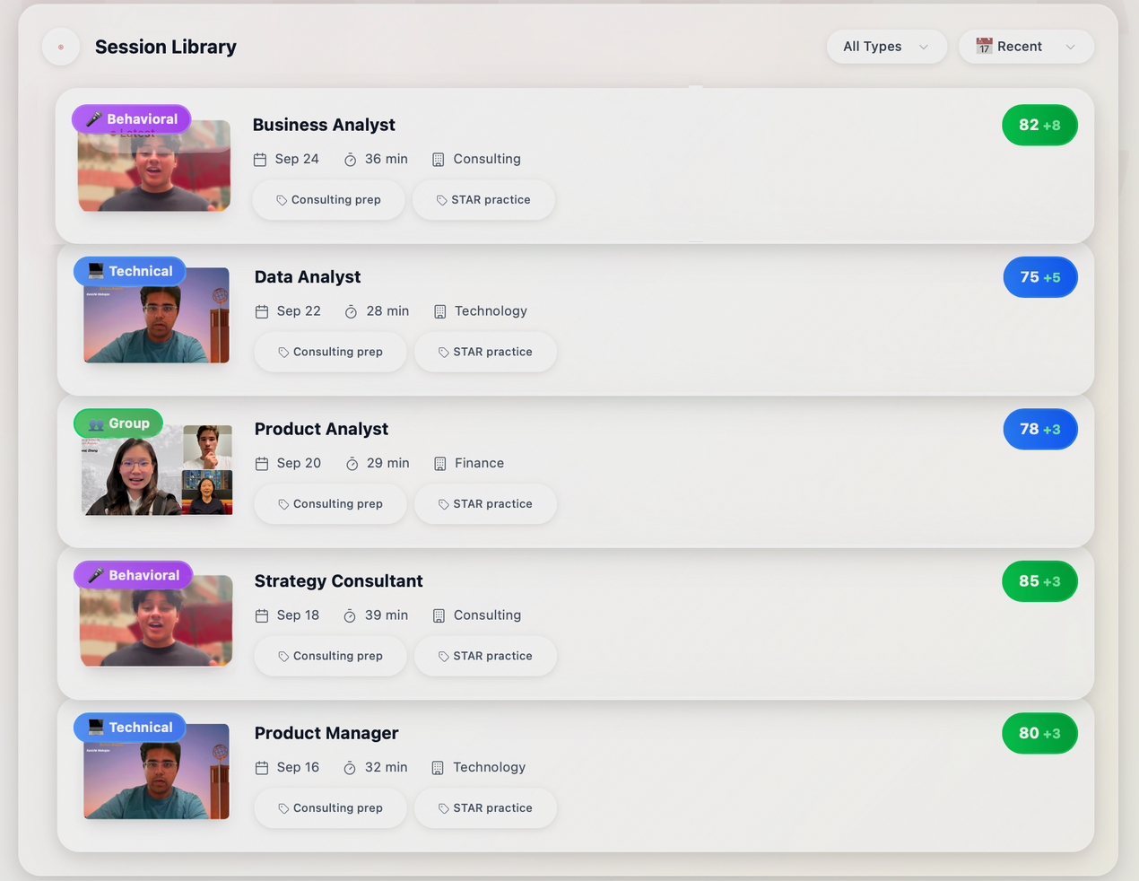
Repository

Slide 10

Rollout Phases
& Driving Behavior Change
Phase 1 – Pilot
Phase 2 – Adoption
Phase 3 – Expansion
BASA & Career Services promotion
Event-based integration
Alumni/faculty question bank
MBA & program-wide access
SSO / LinkedIn integration
Closed beta launch
Feedback collection
Usage tracking & iteration
Month 1
Month 2-4
Month 4-6
Make It Easy
Make It Rewarding
Make It Embedded
Web/mobile access
One-click start
Quick onboarding/tutorial
Instant AI feedback
Visual progress tracking
Career Center endorsement
In-classroom use
Orientation & alumni promotion

Slide 11

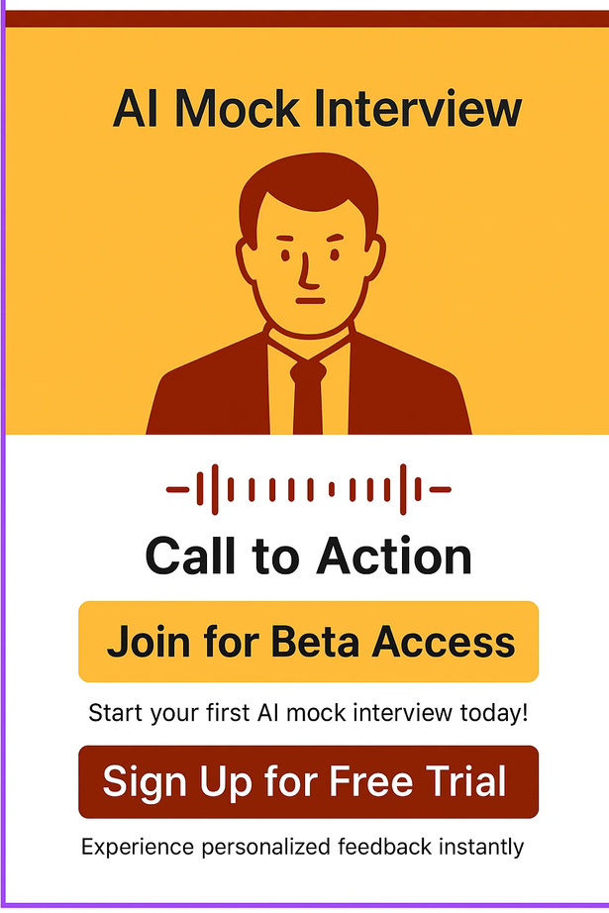



Value Proposition
Personalized
Track Progress
AI provides detailed insights on answers, tone, pacing, and body language
Analytics dashboard shows improvement over time and highlights areas to focus on
Flexibility
Realistic
Conduct interviews at your convenience without needing a human interviewer
Simulates real interview scenarios with diverse industries, roles, and question types

Slide 12
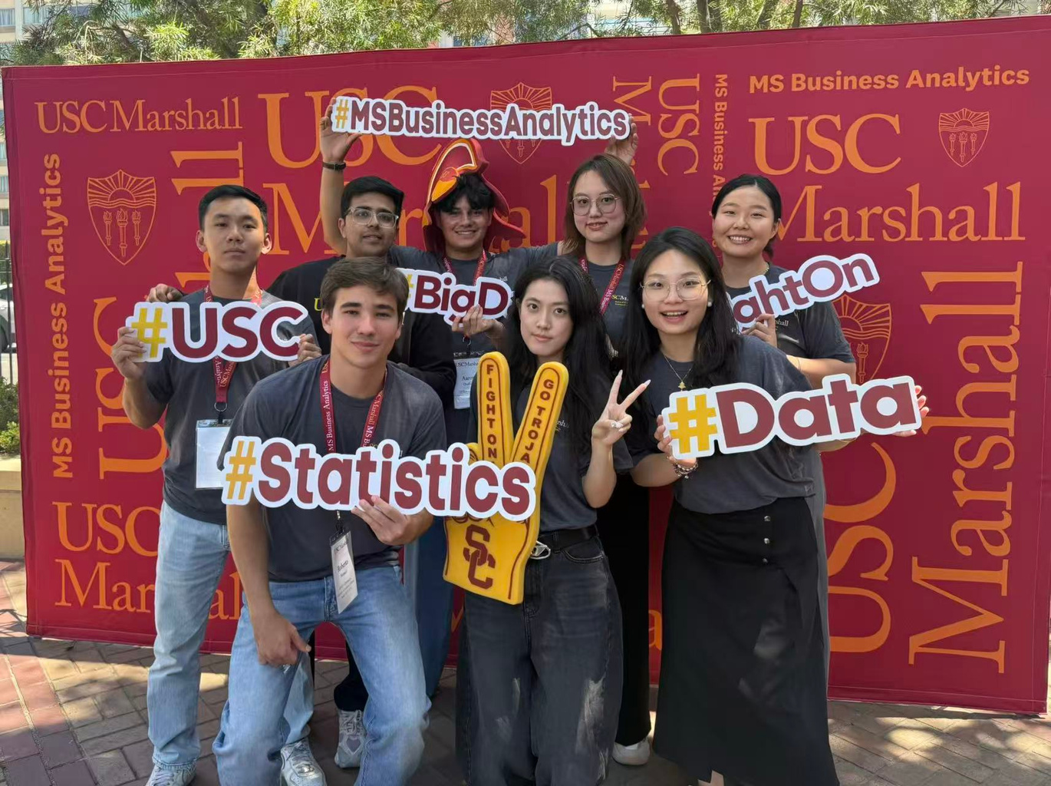
Thank You!
Roberto Monaco
Aaron Orellana
Rona Zhang
Le Luo
Claudia Lyu
Kaiwen Ma
Steven Lo
Kanishk Mahajan

